Slide 1
Data Insights From dashboards
BY Mohammed Adeen shaik

Slide 2
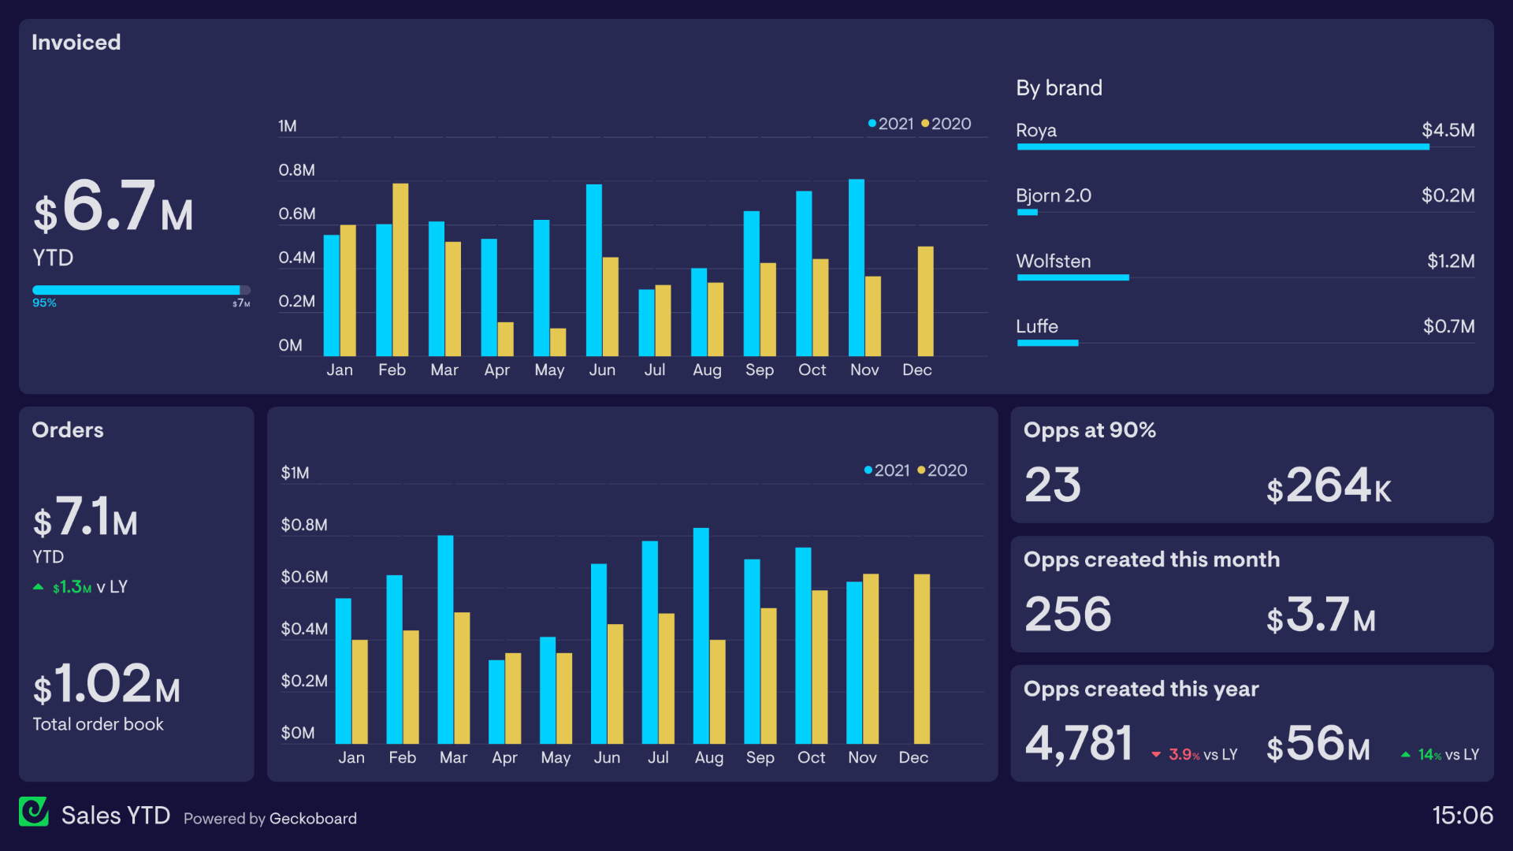
Overview of Account Sales Performance
Key Points:
Year-to-Date (YTD) Sales: $6.7M invoiced, $7.1M orders.
Growth Comparison: $1.3M increase in orders compared to last year.
Top Performing Brand: Roya, contributing $4.5M in sales.
Low Performing Brands: Bjorn 2.0 ($0.2M), Luffe ($0.7M).

Slide 3
Monthly Sales Analysis
Monthly Sales Trends
Key Points:
Seasonal Trends: Significant spikes in February and November for both invoiced and orders.
Year-over-Year Growth: 2021 consistently outperforms 2020 across most months.

Slide 4
Sales Opportunities and Pipeline
Sales Pipeline and Opportunities
Key Points:
High-Confidence Opportunities: 23 opportunities at 90%, valued at $264K.
New Opportunities Created: 256 this month, totaling $3.7M.
Annual Opportunity Creation: 4,781 opportunities, $56M value, up 14% YoY.

Slide 5
Actionable Recommendations for Growth
Key Recommendations:
Focus on High Performers: Continue investment in top-performing brands like Roya.
Revitalize Underperforming Brands: Implement targeted marketing and sales strategies for Bjorn 2.0 and Luffe.
Leverage Seasonal Trends: Plan campaigns around peak months to maximize sales.
Optimize Sales Pipeline: Enhance follow-up on high-confidence opportunities to ensure conversion.

